Slide 1
CT5102: Programming for Data Analytics Lecture 12: Calling Python from R using reticulate
Dr. Jim Duggan,
School of Engineering & Informatics
National University of Ireland Galway.
https://github.com/JimDuggan/CT5102

Slide 2
Overview
Overall approach
Creating a package in Python
Loading into R
Running the Python functions & benchmark

Slide 3
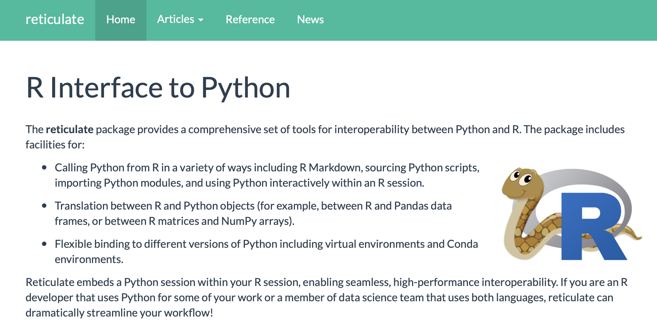
https://rstudio.github.io/reticulate/

Slide 4
Overall Approach
R Script
reticulate
package
Python Package
setup.py
mystats
folder
functions.py
__init__.py

Slide 5
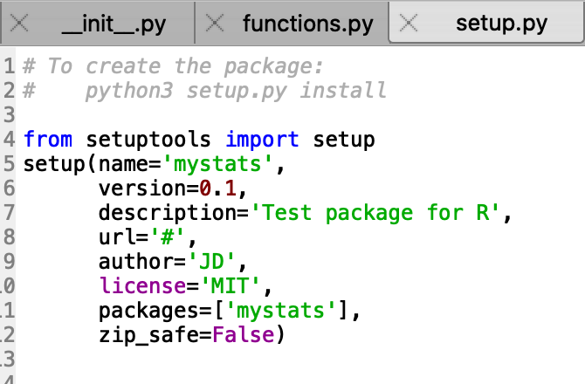
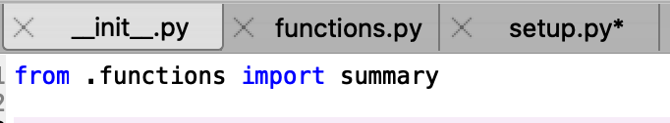
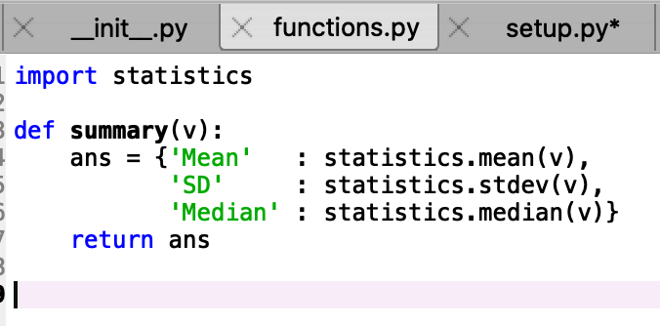
Sample Python Package mystats

Slide 6
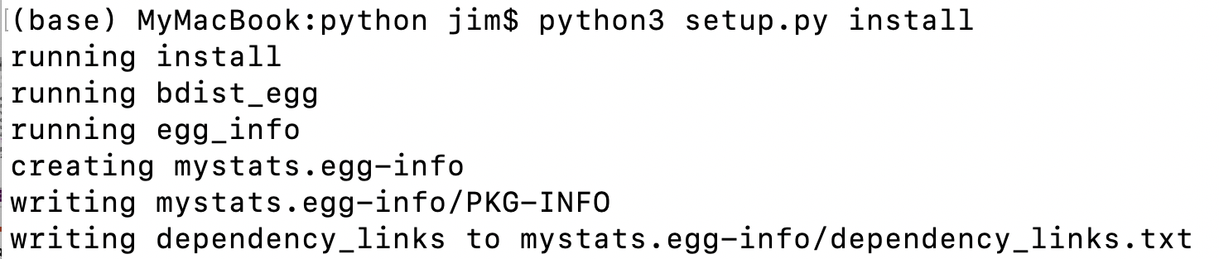
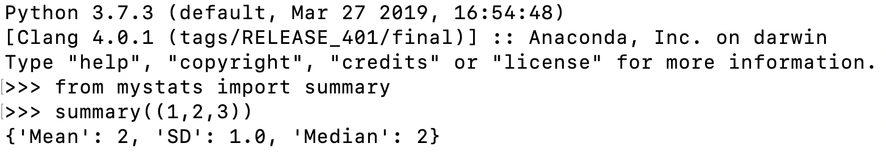
Building the package for system-wide use

Slide 7
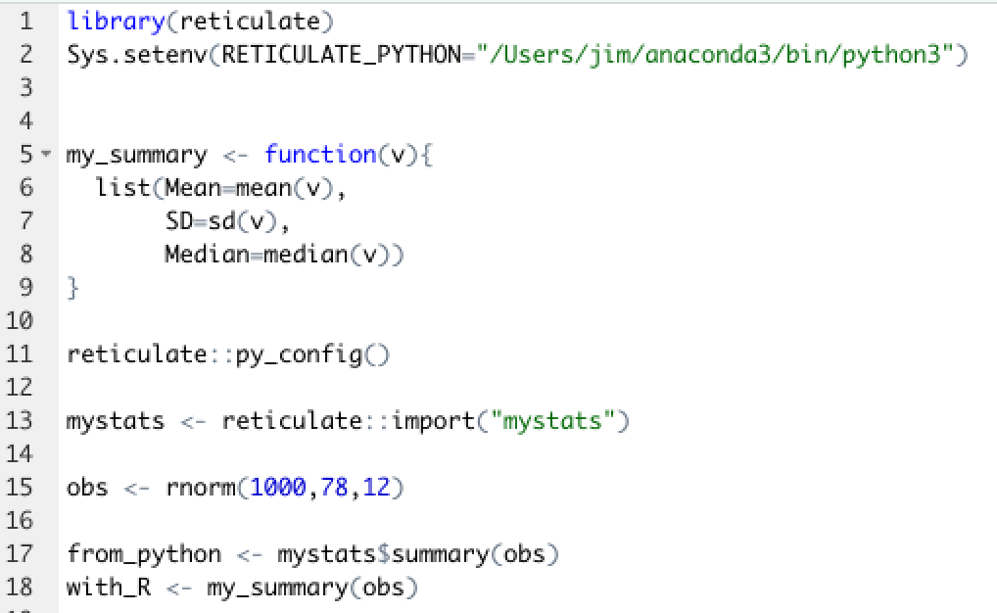
R Code

Slide 8
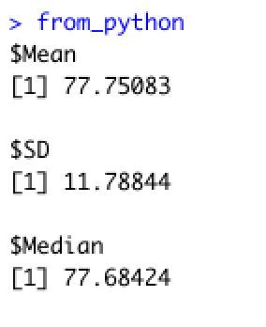
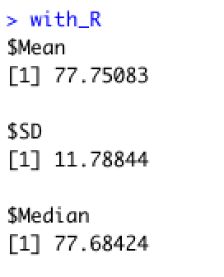
Comparing Output

Slide 9
Type Conversions
R | Python | Examples
Single-element vector | Scalar | 1, 1L, TRUE
Multi-element vector | List | c(1.0,2.0,3.0)
List of multiple types | Tuple | list(1L,TRUE,”foo”)
Named list | Dict | List(a=1,b=2)
Matrix/array | NumPy Array | matrix(1:4,nrow=2)
Data Frame | Pandas Data Frame | data.frame()
When calling into Python, R data types are automatically converted to their equivalent Python types
When values are returned from Python, they are converted back to R types

Slide 10
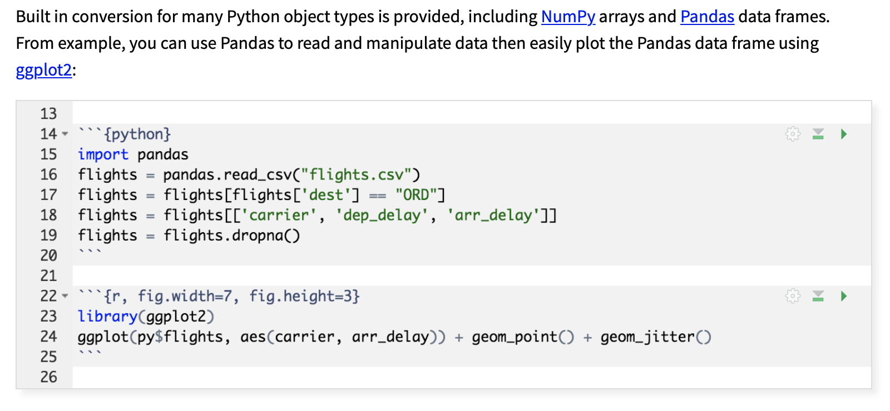
Further information
https://blog.rstudio.com/2018/03/26/reticulate-r-interface-to-python/

Slide 11
Summary
Facilitates function calls from R to Python
Many objects automatically translated
Provide mechanism for also integrating Python with RShiny
https://github.com/JimDuggan/CT5102/tree/master/code/course/12%20reticulate

Slide 12




Course Summary Part I - Base R

Slide 13


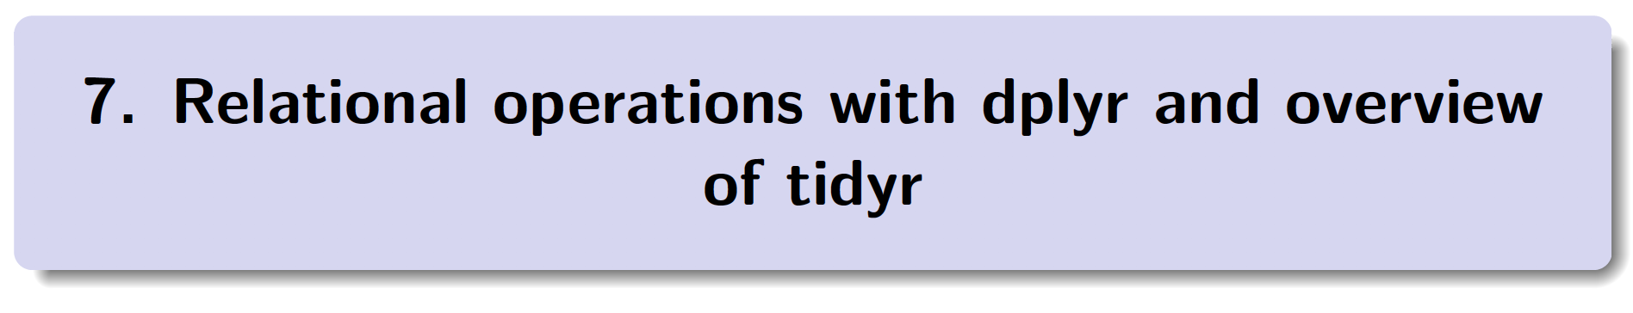
Course Summary Part II – tidyverse

Slide 14



Course Summary Part III – Advanced R

Slide 15


Course Summary Part IV – Developing Apps

